Slide 1

Typing Speed Test: A Java Approach
This project delves into the creation of a typing speed test application using Java programming. It aims to provide a user-friendly interface for testing typing skills, calculating words per minute (WPM), and offering feedback.

Slide 2
INDEX
Introduction
Project overview
Working
Creating type test interface
Capturing user input
WPM
Results
Conclusion

Slide 3

Introduction to Typing Speed Measurement
1
Measuring Proficiency
2
Practice and Improvement
Typing speed is a common metric for evaluating keyboarding skills, indicating how quickly and accurately a person can type.
Typing speed tests can be a valuable tool for identifying strengths and weaknesses, guiding practice, and tracking progress over time.
3
Applications
Typing speed tests are frequently used in various settings, such as job applications, educational assessments, and online gaming.

Slide 4
Project Overview: Typing Speed Test using Java
This project is a Java-based application designed to measure a user's typing speed and accuracy. Users are prompted to type a given passage, and the program calculates their typing speed in words per minute (WPM) and accuracy by comparing the typed input with the provided text. The program uses a timer to track how long it takes the user to complete the test, and any typing errors are highlighted to calculate accuracy. It also offers features like retrying tests and displaying final results. This project demonstrates Java's string manipulation, timing, and input/output handling capabilities.

Slide 5
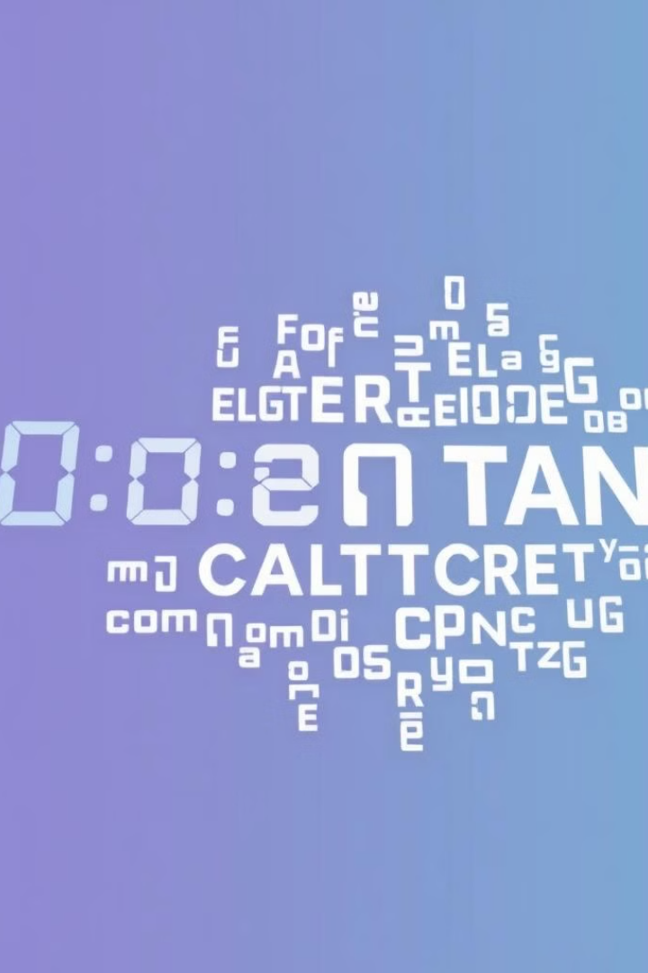
Key Concepts: Words per Minute (WPM)
Calculation
Accuracy
WPM is calculated by dividing the number of correctly typed words by the time taken in minutes.
Typing accuracy is crucial, and errors can significantly impact the WPM score.
Benchmarking
WPM scores are often compared to benchmarks or average scores for different skill levels.

Slide 6
Creating the Typing Test Interface
User Input Area
Timer Display
Results Section
A text box for users to type in the given text.
A visual countdown timer to track the test duration.
An area to display the final WPM score, accuracy, and potentially other metrics.

Slide 7

Capturing User Input and Timing
1
Input Event Handling
The application needs to capture each keystroke in real-time.
2
Timing Mechanism
A timer is used to record the start and end times of the test.
3
Data Storage
The typed text and the elapsed time are stored for subsequent calculations.

Slide 8




Calculating Typing Speed (WPM)
Word Count
The typed text is analyzed to determine the number of correct words.
Time Conversion
The elapsed time is converted from milliseconds to minutes.
Calculation
The WPM is calculated by dividing the word count by the time in minutes.

Slide 9
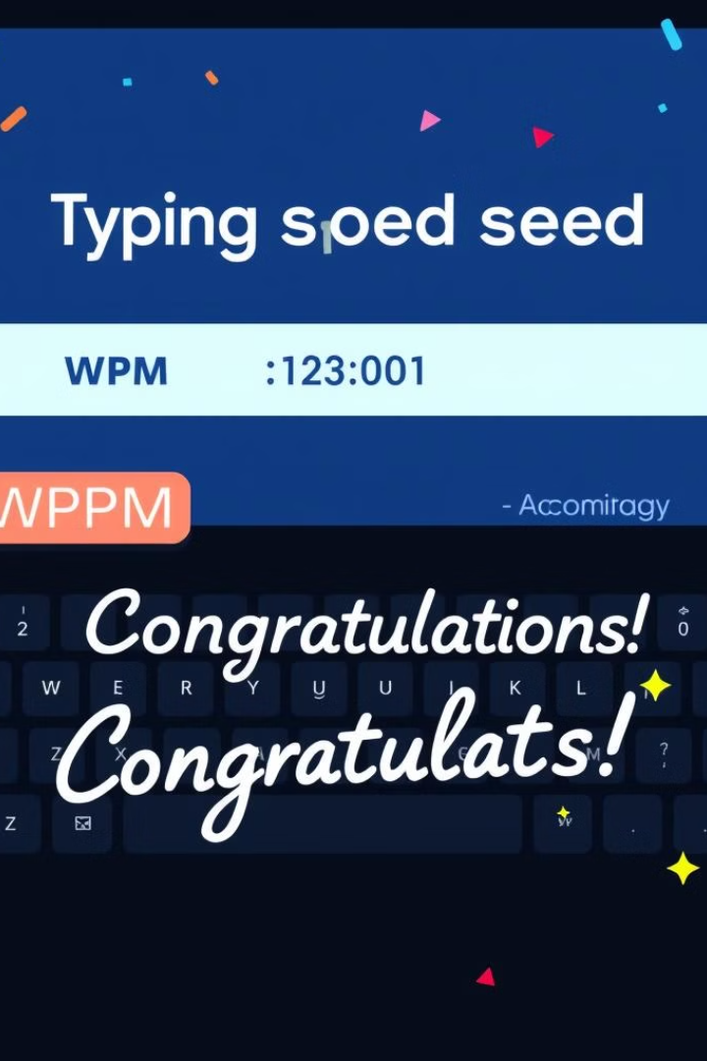



Displaying Results and Feedback
Score Display
The final WPM score is displayed prominently.
Accuracy Feedback
The percentage of correctly typed words is provided.
Progress Tracking
The application could store and display historical scores for progress monitoring.

Slide 10
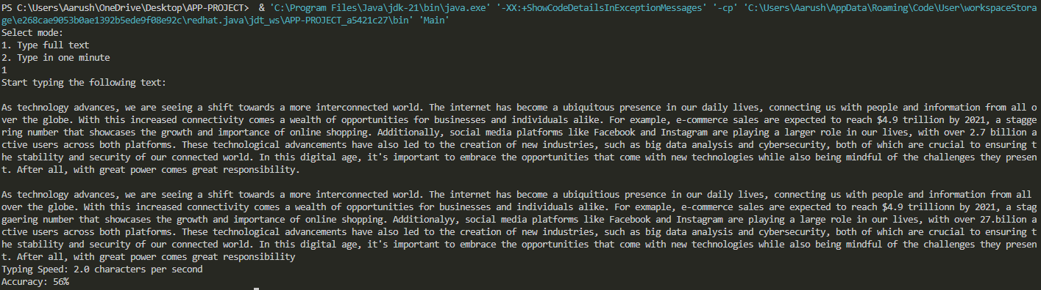
Determining the speed test from a given data

Slide 11
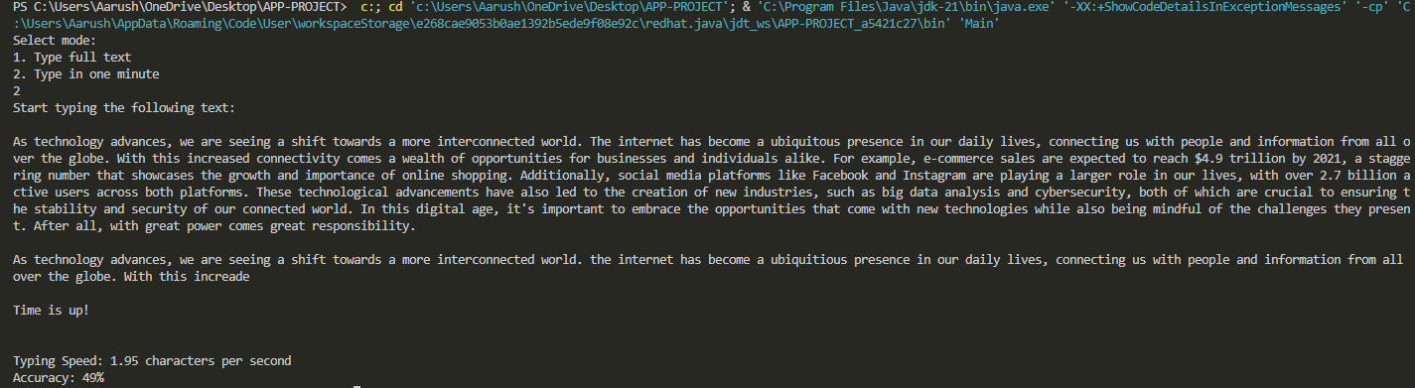
Determining the speed test in one minute

Slide 12
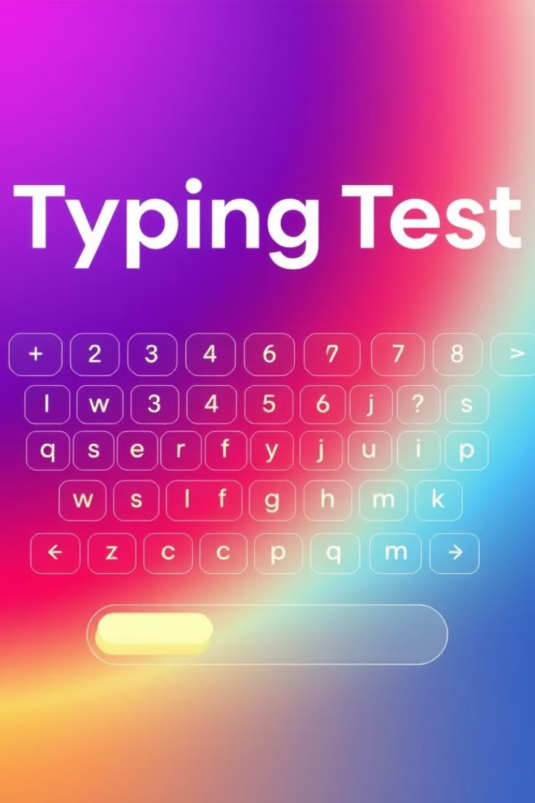
Enhancing the Experience with Visual Aids
Animation
Visual feedback as users type, like highlighting correct words.
Color Coding
Differentiating correct and incorrect characters.
Interactive Elements
Adding elements like a progress bar or a countdown timer to engage users.

Slide 13
Conclusion
In conclusion, the Typing Speed Test serves as both a functional tool for improving typing skills and a demonstration of how Java's core functionalities can be applied to real-world problems. It underscores the importance of programming in creating applications that contribute to personal development and performance benchmarking. Through continuous refinement, the program could evolve into a robust platform that integrates more complex metrics and personalized feedback systems.
Here's an example of a visual representation of the typing speed test results:
Speed and Accuracy Display: A results screen showcasing the WPM and accuracy in percentage.
Interactive Typing Section: Where users input text with a live feedback mechanism.

Slide 14


